Slide 1





BITCOIN PRICE PREDICTION USING MACHINE LEARNING
Team Members: Guide : SHILPA HARIRAJ
KARNA KAVYA(1VE20CA027)
MOHIT KUMAR SINGH(1VE20CA011)
RISHIKA S(1VE20CA019)
TRIPARNA ROY(1VE20CA022)
Disclaimer: The content is curated for educational purposes only.
Notes:
TEAM ASCENT(S.V.C.E)

Slide 2
OUTLINE
Abstract
Problem Statement
Aims, Objective & Proposed Solution
System Design/Architecture
System Development Approach
Dataflow Diagram
Algorithm & Deployment
Conclusion
Future Scope
References
Notes:
These are the list of chapters that we are going to cover in these foundation codes. Those are chapter one what are AI and ML? chapter 2 applied Python programming in AI, and chapter 3 is exploratory data analysis for ML.

Slide 3
Abstract
This study employs the Yahoo Finance API to collect historical price data for BTC, ETH, USDT, and BNB. Preprocessing consolidates and refines the data, followed by visual EDA using Seaborn and Matplotlib to analyze closing prices and volumes across cryptocurrencies. Correlations are scrutinized via heatmaps and pair plots.
Regression models—Random Forest, K Nearest Neighbors, Decision Tree, Gradient Boosting—are applied to forecast Bitcoin's closing price using other cryptocurrencies' features. Key steps include train-test splitting, feature scaling, and RandomizedSearchCV for refining the Random Forest Regressor's performance.
Notes:
Brief Overview:
This study focuses on the analysis and forecasting of cryptocurrency prices.Utilizing historical data for BTC, ETH, USDT, and BNB obtained through the Yahoo Finance API.
Cryptocurrencies Included:
Collected historical price data for Bitcoin (BTC), Ethereum (ETH), Tether (USDT), and Binance Coin (BNB).
Data Source:
Leveraged the Yahoo Finance API for reliable and comprehensive data.
Consolidation and Refinement:
Conducted preprocessing to consolidate and refine the collected data.Essential for ensuring accuracy and reliability in subsequent analyses.
Visualization Tools:
Utilized Seaborn and Matplotlib for visual exploratory data analysis.
Focus Areas:
Emphasis on analyzing closing prices and volumes across the selected cryptocurrencies.
Visualization Techniques:
Employed heatmaps and pair plots to scrutinize correlations between variables.
Importance:
Understanding relationships between cryptocurrency prices is crucial for comprehensive analysis.
Models Applied:
Utilized Random Forest, K Nearest Neighbors, Decision Tree, and Gradient Boosting.
Objective:
Forecasting Bitcoin's closing price using features from other cryptocurrencies.
Key Steps:
Implemented train-test splitting to assess model performance.
Conducted feature scaling for data normalization.
Applied RandomizedSearchCV to refine the Random Forest Regressor's performance.
Summary:
Presented findings and insights obtained from the regression models.
Highlighted key metrics and evaluation results for comprehensive understanding.

Slide 4
Problem Statement
Cryptocurrency markets, known for their volatility, present a challenge in accurately predicting Bitcoin's (BTC) price movements amid interactions with Ethereum (ETH), Tether (USDT), and Binance Coin (BNB). This study aims to utilize machine learning for BTC price forecasting based on historical data from these cryptocurrencies via the Yahoo Finance API.
Notes:
Volatility in Cryptocurrency Markets:
Cryptocurrency markets are acknowledged for their high volatility.
Volatility refers to the rapid and unpredictable price changes that can occur within a short period.
Challenge in Predicting BTC Price Movements:
The inherent volatility poses a challenge in accurately predicting the price movements of Bitcoin (BTC).
Predicting BTC prices requires overcoming the uncertainties and fluctuations prevalent in the cryptocurrency market.
Interactions with Other Cryptocurrencies:
The study considers the interactions of Bitcoin with other major cryptocurrencies: Ethereum (ETH), Tether (USDT), and Binance Coin (BNB).
Recognizes that the performance of these cryptocurrencies may influence or be influenced by Bitcoin.
Utilization of Machine Learning:
The primary approach of the study is to leverage machine learning techniques for BTC price forecasting.
Machine learning offers the ability to analyze historical data and identify patterns that may contribute to more accurate predictions.
5. Historical Data from Yahoo Finance API:
The study relies on historical data obtained from the Yahoo Finance API.
Yahoo Finance API serves as a reliable source for comprehensive financial market data, including cryptocurrency prices.

Slide 5
Aim and Objective
Aim:
To predict Bitcoin's (BTC) closing price leveraging machine learning techniques using historical data from Ethereum (ETH), Tether (USDT), and Binance Coin (BNB), obtained through the Yahoo Finance API.
Objectives:
Data Collection and Preparation: Gather historical price data for BTC, ETH, USDT, and BNB from the Yahoo Finance API.
Machine Learning Modeling: Implement regression models (Random Forest, K Nearest Neighbors, Decision Tree, Gradient Boosting) to forecast BTC's closing price.
Exploratory Data Analysis (EDA): Visualize closing prices and volumes across cryptocurrencies using Seaborn and Matplotlib.
Model Interpretability using SHAP: Employ SHAP values to interpret the Random Forest model's predictions
Notes:
Predictive Focus on BTC Closing Price:
The primary aim of the study is to predict Bitcoin's (BTC) closing price, emphasizing the significance of forecasting a key metric in cryptocurrency markets.
Machine Learning Techniques:
The study employs machine learning techniques, specifically regression models, including Random Forest, K Nearest Neighbors, Decision Tree, and Gradient Boosting.
These models are chosen for their ability to capture complex relationships in the data and provide accurate predictions.
Comprehensive Data Collection:
Data collection is a foundational step, involving the gathering of historical price data for BTC, ETH, USDT, and BNB.
The Yahoo Finance API is utilized as a reliable source for obtaining comprehensive and accurate historical cryptocurrency data.
Visual Exploration through EDA:
Exploratory Data Analysis (EDA) is conducted using visualization libraries such as Seaborn and Matplotlib.
The focus of EDA is on visualizing closing prices and volumes across BTC, ETH, USDT, and BNB, providing insights into historical trends and patterns.
Model Interpretability with SHAP Values:
The study goes beyond model prediction by incorporating SHAP (SHapley Additive exPlanations) values.
SHAP values are employed specifically to interpret the predictions of the Random Forest model, enhancing the understanding of how different features contribute to the model's output.

Slide 6
Proposed Solution
The proposed solution involves collecting historical BTC, ETH, USDT, and BNB data via Yahoo Finance API, followed by data refinement. Exploratory analysis visualizes price trends and correlations among cryptocurrencies. Feature engineering integrates data for BTC price prediction using regression models like Random Forest and Gradient Boosting, optimizing with train-test splits and hyperparameter tuning. Model evaluation via metrics guides interpretation using SHAP values, unraveling feature impacts on BTC price predictions. This comprehensive approach aims for accurate BTC closing price forecasting while enhancing model transparency.
Notes:
Holistic Data Collection and Refinement:
The proposed solution begins with the comprehensive collection of historical data for Bitcoin (BTC), Ethereum (ETH), Tether (USDT), and Binance Coin (BNB) using the Yahoo Finance API.
The subsequent data refinement process ensures that the collected data is accurate, reliable, and suitable for analysis.
Exploratory Analysis for Price Trends and Correlations:
The solution incorporates exploratory data analysis (EDA) to visualize and understand price trends across BTC, ETH, USDT, and BNB.
Correlation analysis is performed to uncover relationships and dependencies among the cryptocurrency prices, providing valuable insights.
Feature Engineering for BTC Price Prediction:
Feature engineering is applied to integrate relevant data for BTC price prediction.
This step involves selecting and transforming features to enhance the predictive capabilities of regression models.
Regression Models and Model Optimization:
The solution employs regression models, specifically Random Forest and Gradient Boosting, for BTC price prediction.
To optimize model performance, the study incorporates essential steps such as train-test splits and hyperparameter tuning, ensuring the models are well-suited for accurate forecasting.
Model Interpretation with SHAP Values:
Model evaluation is conducted using various metrics to assess the performance of the regression models.
The study goes beyond conventional evaluation by employing SHAP (SHapley Additive exPlanations) values, offering insights into the impact of different features on BTC price predictions and enhancing the transparency of the models.

Slide 7
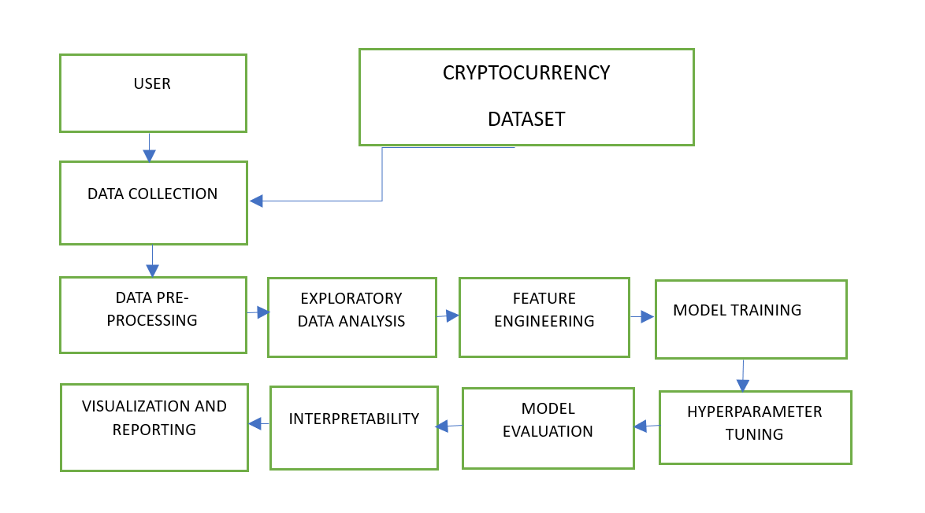
BLOCK DIAGRAM
BITCOIN(CRYPTO) PRICE PREDICTION MODEL
Notes:
Cryptocurrency Price Prediction System - Data Flow Diagram
External Entities:
User:
Initiates the system by interacting with it.
Provides input preferences and receives predictions.
Cryptocurrency Dataset (Yahoo Finance):
External source supplying historical price data for BTC, ETH, USDT, and BNB.
Processes:
Data Collection:
Gathers historical price data from Yahoo Finance for BTC, ETH, USDT, and BNB.
Data Preprocessing:
Cleans and prepares the collected data for further analysis.
Handles missing values and outliers.
Exploratory Data Analysis (EDA):
Utilizes Seaborn and Plotly for visualizations.
Gains insights into market trends and statistical characteristics.
Feature Engineering:
Selects relevant features from the data to enhance model training.
Model Training (KNN, Random Forest, Gradient Boosting):
Utilizes machine learning algorithms to train models for predicting BTC closing prices.
Hyperparameter Tuning (Random Forest):
Optimizes the Random Forest model for improved performance.
Model Evaluation:
Assesses model performance using metrics like R-squared scores, MAE, and MSE.
Interpretability with SHAP Values:
Utilizes SHAP values to enhance interpretability.
Provides insights into feature importance.
Visualization & Reporting:
Generates visualizations and comprehensive reports for user understanding.
Data Stores:
Cryptocurrency Dataset:
Stores historical price data obtained from Yahoo Finance.
Model Configurations:
Stores configurations for the trained models.
Model Outputs:
Stores the results and predictions generated by the trained models.
Data Flow:
Data flows from the external entities (User, Cryptocurrency Dataset) into the system processes.
Processed data flows between each process, incorporating cleaning, analysis, and training.
Trained models flow into the evaluation and interpretability processes.
Visualization and reporting components utilize the outputs from the model evaluation and interpretability processes.
Visualizations and reports are presented to the user as the final output.
This textual representation outlines the primary components and the flow of data within the cryptocurrency price prediction system. You can use this information to create a visual DFD using a diagramming tool like Microsoft Visio, Lucidchart, or any other tool of your choice.

Slide 8
System Architecture
The system architecture encompasses data acquisition via the Yahoo Finance API for BTC, ETH, USDT, and BNB.
Regression models (e.g., Random Forest, Gradient Boosting) predict BTC prices, optimized through Scikit-learn's techniques.
Model evaluation occurs using metrics like R-squared, aided by train-test splits and hyperparameter tuning.
SHAP values provide interpretability, visualizing feature impacts on predictions.
Deployment in cloud environments enables API accessibility for real-time or batch predictions, forming a streamlined architecture blending data processing, analysis, modeling, interpretability, and deployment for robust BTC price forecasting.
Notes:
Data Acquisition via Yahoo Finance API:
The system architecture begins with the acquisition of historical data for Bitcoin (BTC), Ethereum (ETH), Tether (USDT), and Binance Coin (BNB) using the Yahoo Finance API.
This ensures a reliable and up-to-date source of financial data for subsequent analysis and modeling.
Regression Modeling and Optimization with Scikit-learn:
Regression models, including Random Forest and Gradient Boosting, are employed for predicting BTC prices.
Scikit-learn's techniques are utilized for model optimization, enhancing the performance and accuracy of the predictive models.
Model Evaluation and Metric Utilization:
The system incorporates thorough model evaluation using metrics such as R-squared.
Train-test splits and hyperparameter tuning are applied as part of the evaluation process, ensuring the models are robust and capable of accurate BTC price forecasting.
Interpretability with SHAP Values:
SHAP (SHapley Additive exPlanations) values are leveraged to provide interpretability to the regression models.
These values visualize the impact of different features on BTC price predictions, enhancing the transparency and understanding of the underlying factors driving the model's outputs.
Cloud Deployment for Real-Time or Batch Predictions:
The system is designed for deployment in cloud environments, allowing API accessibility for both real-time and batch predictions.
This enables users to access the BTC price forecasting system seamlessly, facilitating the integration of predictions into various applications or workflows.

Slide 9
System Deployment Approach
The System Deployment Approach involves serializing trained models, containerizing the application using Docker for portability, and deploying it on cloud platforms like AWS or Azure. API development via frameworks like Flask facilitates real-time predictions. Load balancing ensures stability, and auto-scaling accommodates varying workloads.
Monitoring tools like Prometheus track performance, while logging systems (e.g., ELK stack) aid error tracking. Security measures include encryption, authentication, and access controls. Employing CI/CD pipelines ensures automated testing, deployment, and version control updates. This comprehensive strategy guarantees a scalable, secure, and accessible system for real-time or batch predictions while maintaining reliability and monitoring capabilities.
Notes:
Serialization and Containerization for Portability:
Trained models are serialized for efficient storage and transportation, and the application is containerized using Docker.
Serialization ensures that models can be easily stored and transported, while containerization provides portability across different environments.
Cloud Deployment on AWS or Azure:
The application is deployed on cloud platforms such as AWS or Azure for scalability, accessibility, and reliability.
Leveraging cloud infrastructure allows for efficient resource management and flexibility in handling varying workloads.
API Development for Real-Time Predictions:
API development, facilitated by frameworks like Flask, enables real-time predictions.
Users can interact with the system through the API, receiving instantaneous predictions for BTC prices.
Load Balancing and Auto-Scaling for Stability:
Load balancing is implemented to distribute workloads evenly across multiple servers, ensuring system stability and preventing performance bottlenecks.
Auto-scaling capabilities adjust resources based on varying workloads, optimizing system performance and responsiveness.
Monitoring, Logging, and Security Measures:
Monitoring tools like Prometheus track system performance, providing insights into resource usage and potential issues.
Logging systems, such as the ELK stack (Elasticsearch, Logstash, Kibana), aid in error tracking and troubleshooting.
Security measures, including encryption, authentication, and access controls, are implemented to safeguard sensitive data and ensure secure system access.

Slide 10
Algorithm & Deployment
Algorithm
Utilize regression algorithms (e.g., Random Forest, Gradient Boosting) for BTC price prediction based on historical data from ETH, USDT, and BNB. Implement train-test splitting, hyperparameter tuning, and evaluation metrics (R-squared) for model optimization.
Deployment
Serialize trained models and containerize the application using Docker. Deploy on cloud platforms (AWS, Azure) with Flask-based APIs for real-time predictions. Ensure load balancing, auto-scaling, and security protocols (encryption, authentication). Monitor performance with tools like Prometheus, logging errors via ELK stack. Implement CI/CD pipelines for automated testing and version control updates, ensuring a scalable, secure, and accessible system for BTC price forecasting.
Notes:
Regression Algorithm Selection for BTC Price Prediction:
Utilize regression algorithms, such as Random Forest and Gradient Boosting, to predict Bitcoin (BTC) prices based on historical data from Ethereum (ETH), Tether (USDT), and Binance Coin (BNB).
The selection of regression algorithms allows for capturing complex relationships in the data for accurate forecasting.
Model Optimization Techniques:
Implement model optimization techniques such as train-test splitting, hyperparameter tuning, and evaluation metrics (e.g., R-squared).
These techniques enhance the performance of the regression models, ensuring they are well-tailored to predict BTC prices with accuracy.
Deployment via Docker and Cloud Platforms:
Serialize trained models to facilitate efficient storage and transportation.
Containerize the application using Docker for portability and deploy it on cloud platforms like AWS or Azure.
Leveraging cloud infrastructure ensures scalability, accessibility, and efficient resource management.
Flask-Based APIs for Real-Time Predictions:
Develop APIs using frameworks like Flask to enable real-time predictions.
Users can interact with the system through these APIs, receiving timely BTC price predictions based on the regression models.
Comprehensive System Deployment and Monitoring:
Ensure load balancing and auto-scaling mechanisms to distribute workloads evenly and accommodate varying levels of demand, optimizing system stability.
Implement security protocols, including encryption and authentication, to safeguard data and control system access.
Monitor system performance using tools like Prometheus, and log errors through the ELK stack for effective tracking and troubleshooting.
Incorporate CI/CD pipelines for automated testing and version control updates, ensuring a streamlined and reliable system for BTC price forecasting.

Slide 11
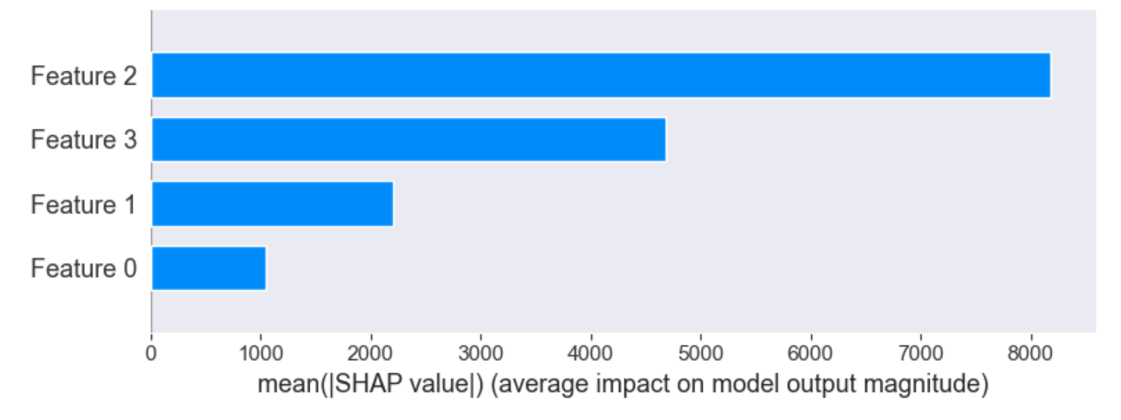
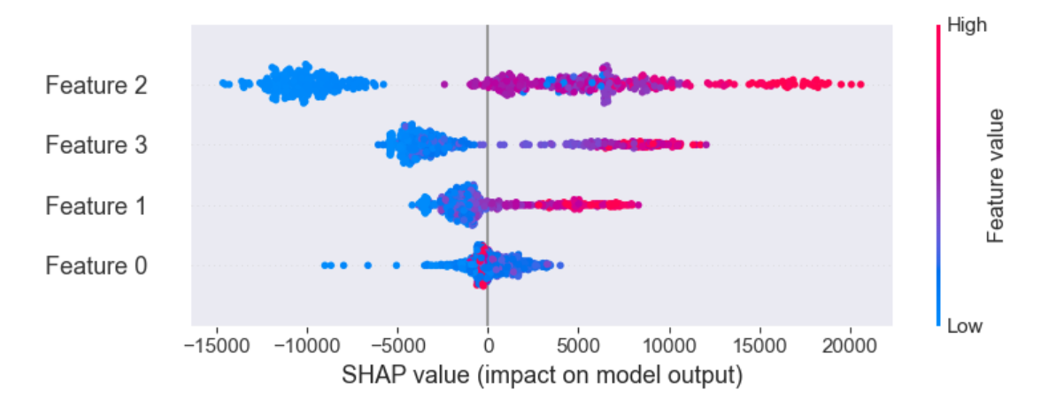
Conclusion
Notes:
These are the resulting graphs obtained

Slide 12
Future Scope
Future endeavors could focus on:
1.Enhanced Model Complexity: Explore ensemble techniques or deep learning models for improved accuracy in predicting cryptocurrency prices amidst market fluctuations.
2.Incorporating External Factors: Integrate external data sources (e.g., social media sentiment, market news) to enhance model robustness and capture broader market influences.
3.Real-Time Predictions: Develop streaming analytics for live price predictions, enabling timely decision-making for traders and investors.
4.Dynamic Model Updating: Implement mechanisms to adapt models to evolving market patterns, ensuring continuous relevance and accuracy.
5.Interdisciplinary Analysis: Collaborate with financial experts to blend machine learning insights with financial theories for more comprehensive predictive models.
Notes:
Enhanced Model Complexity with Ensemble Techniques or Deep Learning:
Explore advanced modeling techniques, such as ensemble methods or deep learning models, to increase the complexity of the predictive models.
These approaches may offer improved accuracy and predictive power, particularly in capturing intricate patterns in cryptocurrency prices amid market fluctuations.
Incorporating External Factors for Model Robustness:
Integrate external data sources, such as social media sentiment and market news, to augment the existing dataset.
This approach enhances the model's robustness by incorporating broader market influences and sentiment analysis, contributing to more informed predictions.
Real-Time Predictions through Streaming Analytics:
Develop and implement streaming analytics capabilities for live price predictions, enabling real-time decision-making for traders and investors.
This feature ensures timely access to predictions and aligns with the dynamic and fast-paced nature of cryptocurrency markets.
Dynamic Model Updating for Continuous Relevance:
Implement mechanisms for dynamic model updating to adapt to evolving market patterns.
Continuous model updates ensure that the predictive models remain relevant and accurate, reflecting the dynamic nature of cryptocurrency markets.
Interdisciplinary Analysis through Collaboration:
Foster collaboration with financial experts to combine machine learning insights with established financial theories.
Interdisciplinary analysis ensures a more comprehensive understanding of market dynamics, potentially leading to more robust and insightful predictive models.

Slide 13
References
www.Kaggle.com
www.github.com
Tom M. Mitchell, Machine Learning, McGraw-Hill Education, 2013
Machine Learning using Python ,Manaranjan Pradhan, U Dinesh Kumar, Wiley 2019
Machine Learning, Anuradha Srinivasaraghavan, VincyJoeph, Wiley 2019
Notes:
Reference
These are the references for this session.
13

Slide 14
Thank you!
Notes:
thank you
14

